Slide 1
Dynamic Programming

Slide 2

Fibonacchi Numbers
$$fib\left(n\right)=fib\left(n−1\right)+fib\left(n−2\right)$$
Write a program to find the nth fibonacchi number.
Runtime analysis
$$T\left(n\right)=T\left(n−1\right)+T\left(n−2\right)+O(1)$$
$$T\left(n\right)=Ω(2^{n/2})$$
def Fibonacci(n):
if n == 0: return 0
if n == 1: return 1
return Fibonacci(n-1) + Fibonacci(n-2)

Slide 3
What’s going on? Consider Fib(8)
That’s a lot of repeated computation!
8
6
7
4
5
5
6
2
3
3
4
3
4
4
5
0
1
1
2
1
2
2
3
1
2
2
3
2
3
3
4
1
2
2
……
0
1
0
1
0
1
1
2
0
1
0
1
0
1
1
1
2
0
1
0
1
0
1
0
1

Slide 4

Fibonacchi Numbers
How to avoid repeated computations?
Store already computed results
global fib[n] initialized to -1/$−∞$/NIL
def Fibonacci(n):
if n == 0: return 0
if n == 1: return 1
if fib[n] not computed:
fib[n] = Fibonacci(n-1) + Fibonacci(n-2)
return fib[n]

Slide 5
Fibonacchi Numbers
How to avoid repeated computations?
Start from smaller problems and proceed towards bigger ones.
def Fibonacci(n):
local fib[n+1]
fib[0] = 0
fib[1] = 1
for i -> 2 to n:
fib[i] = fib[i-1] + fib[i-2]
return fib[n]

Slide 6
What did we do?
Dynamic Programming!!!

Slide 7
Dynamic Programming
It is an algorithm design paradigm
like divide-and-conquer is an algorithm design paradigm.
Usually, it is for solving optimization problems
E.g., shortest path, minimum/maximum profit, longest sequences
(Fibonacci numbers aren’t an optimization problem, but they are a good example of DP anyway…)

Slide 8
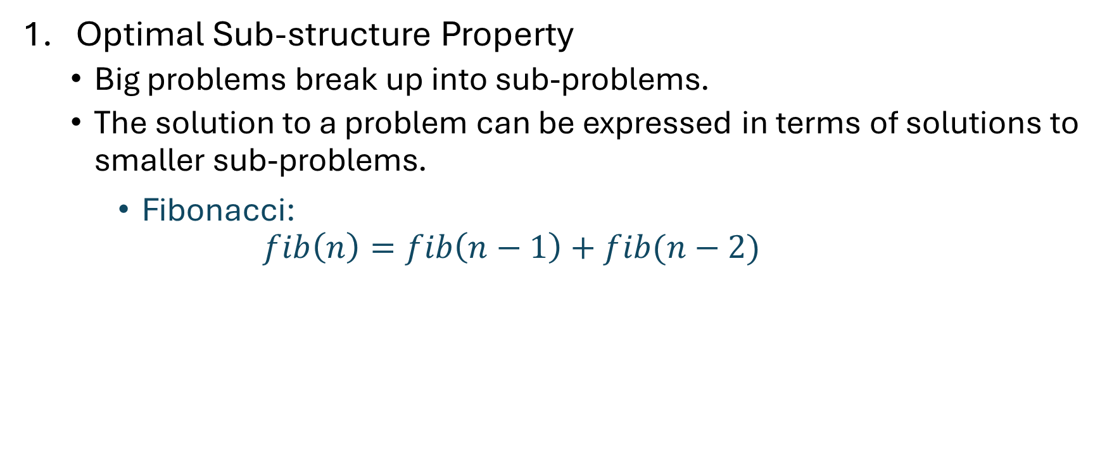
Elements of dynamic programming
Optimal Sub-structure Property
Big problems break up into sub-problems.
The solution to a problem can be expressed in terms of solutions to smaller sub-problems.
Fibonacci:
$$fib\left(n\right)=fib\left(n−1\right)+fib(n−2)$$

Slide 9
Elements of dynamic programming
Overlapping Sub-Problem Property
The sub-problems overlap.
Fibonacci:
Both fib[i+1] and fib[i+2] directly use fib[i].
And lots of different fib[i+x] indirectly use fib[i].
This means that we can save time by solving a sub-problem just once and storing the answer.

Slide 10
Elements of dynamic programming
Optimal substructure.
Optimal solutions to sub-problems can be used to find the optimal solution of the original problem.
Overlapping subproblems.
The subproblems show up again and again
Using these properties, we can design a dynamic programming algorithm:
Keep a table of solutions to the smaller problems.
Use the solutions in the table to solve bigger problems.
At the end we can use information we collected along the way to find the solution to the whole thing.

Slide 11

Two ways to think about and/or implement DP algorithms
Top-down Approach with Memoization
Bottom-up Approach
global fib[n] initialized to -1/$−∞$/NIL
def Fibonacci(n):
if n == 0: return 0
if n == 1: return 1
if fib[n] not computed:
fib[n] = Fibonacci(n-1) + Fibonacci(n-2)
return fib[n]
def Fibonacci(n):
local fib[n+1]
fib[0] = 0
fib[1] = 1
for i -> 2 to n:
fib[i] = Fibonacci(i-1) + Fibonacci(i-2)
return fib[n]

Slide 12
Top-down Approach
Think of it like a recursive algorithm.
To solve the big problem:
Recurse to solve smaller problems
Those recurse to solve smaller problems
etc..
The difference from divide and conquer:
Keep track of what small problems you’ve already solved to prevent re-solving the same problem twice.
Aka, “memo-ization”

Slide 13
Top-down Approach
8
6
7
4
5
5
6
2
3
3
4
3
4
4
5
0
1
1
2
1
2
2
3
1
2
2
3
2
3
3
4
1
2
2
etc
0
1
0
1
0
1
1
2
0
1
0
1
0
1
1
1
2
0
1
0
1
0
1
0
1

Slide 14
Top-down Approach
Nodes Pruned
8
6
7
4
5
5
6
2
3
3
4
3
4
4
5
0
1
1
2
1
2
2
3
1
2
2
3
2
3
3
4
1
2
2
etc
0
1
0
1
0
1
1
2
0
1
0
1
0
1
1
1
2
0
1
0
1
0
1
0
1

Slide 15
Bottom-up Approach
8
7
Solve the small problems first
fill in fib[0],fib[1]
Then bigger problems
fill in fib[2]
…
Then bigger problems
fill in fib[n-1]
Then finally solve the real problem.
fill in fib[n]
6
5
4
3
2
1
0

Slide 16

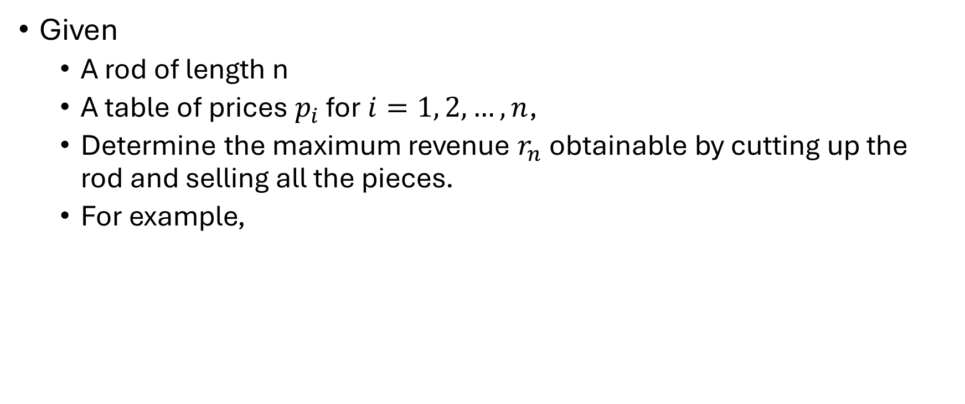
Rod-cutting Problem
Given
A rod of length n
A table of prices $p_{i}$ for $i=1, 2, …, n$,
Determine the maximum revenue $r_{n}$ obtainable by cutting up the rod and selling all the pieces.
For example,

Slide 17
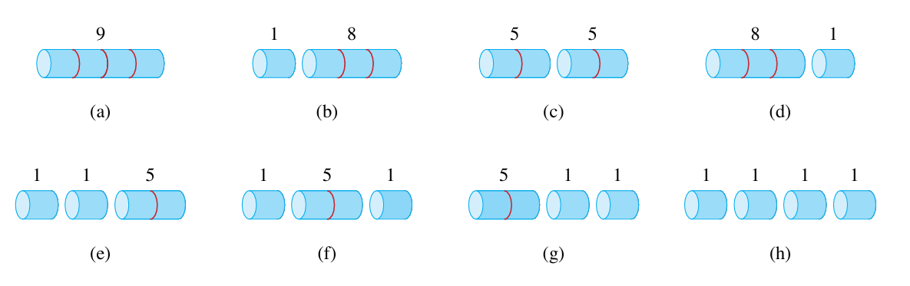
Rod-cutting Problem

Slide 18

Rod-cutting Problem
An optimal solution involving k pieces,
Each piece has length $i_{1}, i_{2},i_{3},…, i_{k}$
${n= i}_{1}+ i_{2}+i_{3}+…+ i_{k}$
The optimal revenue, ${r_{n}=p}_{i_{1}}+ p_{i_{2}}+…+ p_{i_{k}}$

Slide 19
Rod-cutting Problem
Once an initial cut is made,
The two resulting smaller pieces will be cut independently
Smaller instance of the rod-cutting problem
Optimal Sub-structure Property
Different pieces can be cut into same length pieces (on not)
Overlapping Sub-structure Property

Slide 20
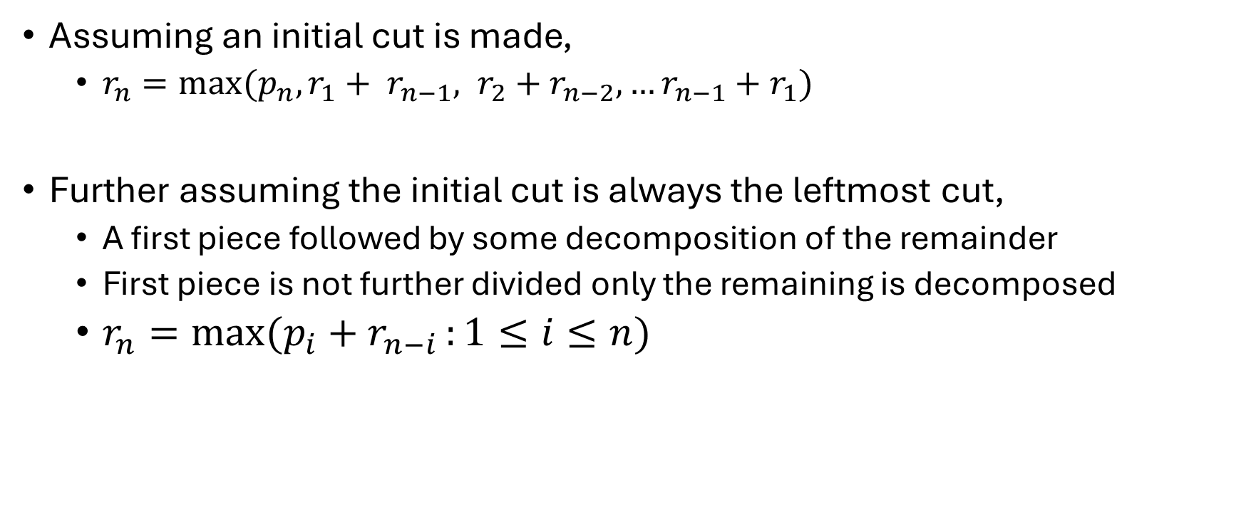
Rod-cutting Problem
Assuming an initial cut is made,
${r_{n}=max⁡(p_{n}, r}_{1}+ r_{n−1}, r_{2}+r_{n−2}, …r_{n−1}+r_{1})$
Further assuming the initial cut is always the leftmost cut,
A first piece followed by some decomposition of the remainder
First piece is not further divided only the remaining is decomposed
$r_{n}=max⁡(p_{i}+r_{n−i }:1≤i≤n)$

Slide 21
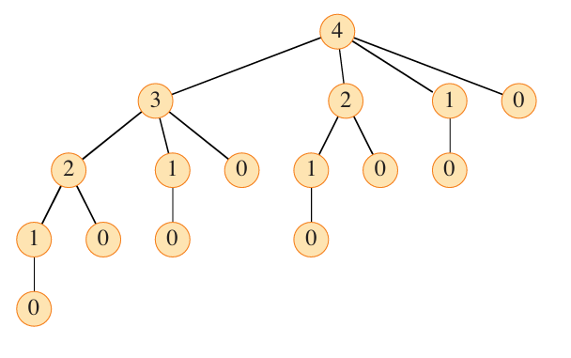
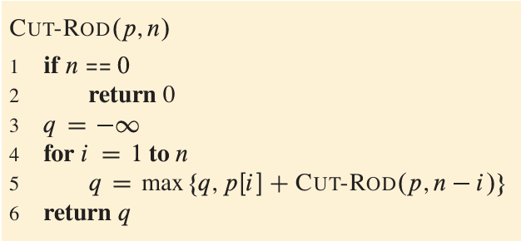
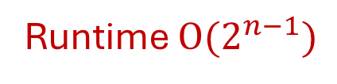
Rod-cutting Problem
Runtime $O(2^{n−1})$

Slide 22
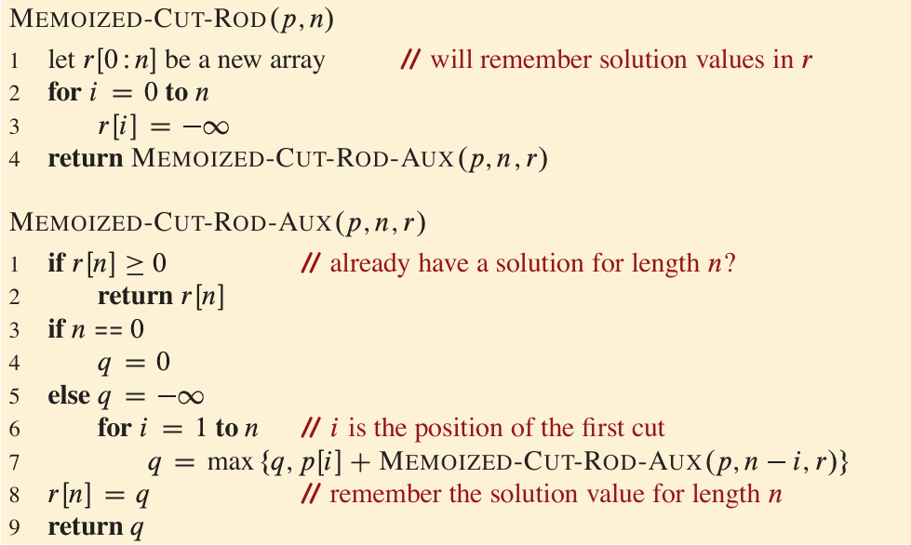
Rod-cutting Problem (Top-down Approach)

Slide 23
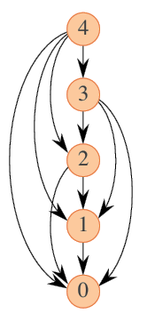
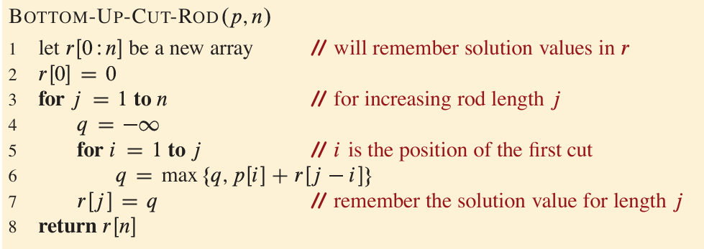
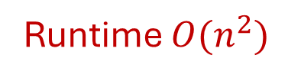
Rod-cutting Problem (Bottom-up Approach)
Runtime $O(n^{2})$

Slide 24
Rod-cutting Problem (Bottom-up Approach)
Reconstruct the choices that led to the optimal solution
Store the choices that lead to the optimal solution
Store the optimal size i of the first piece to cut off when solving a subproblem of size j

Slide 25
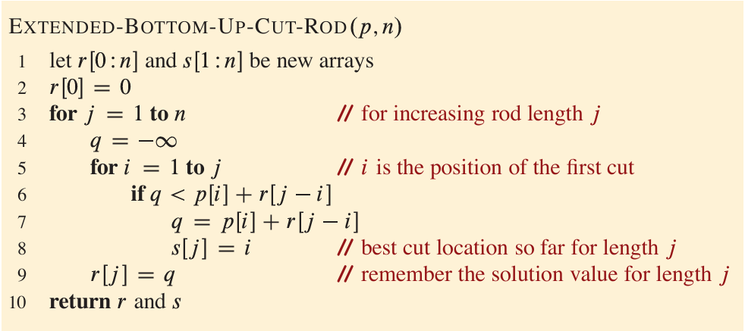
Rod-cutting Problem (Bottom-up Approach)

Slide 26
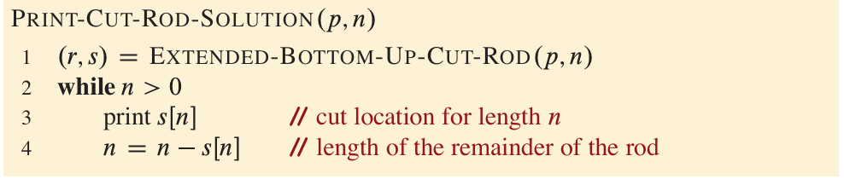
Rod-cutting Problem (Bottom-up Approach)

Slide 27
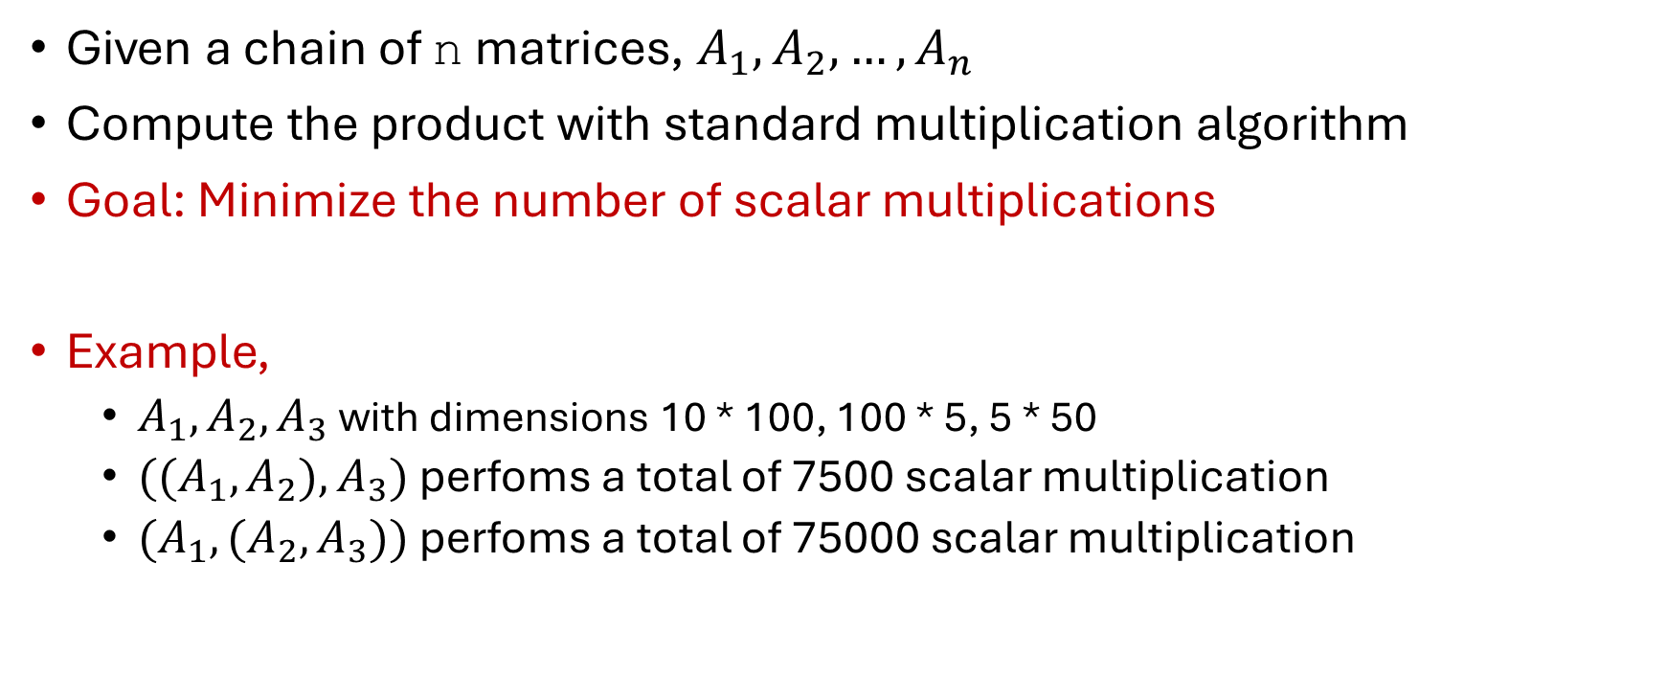
Matrix Chain Multiplication
Given a chain of n matrices, $A_{1},A_{2},…, A_{n}$
Compute the product with standard multiplication algorithm
Goal: Minimize the number of scalar multiplications
Example,
$A_{1},A_{2}, A_{3}$ with dimensions 10 * 100, 100 * 5, 5 * 50
${((A}_{1},A_{2}), A_{3})$ perfoms a total of 7500 scalar multiplication
${(A}_{1},(A_{2}, A_{3}))$ perfoms a total of 75000 scalar multiplication

Slide 28
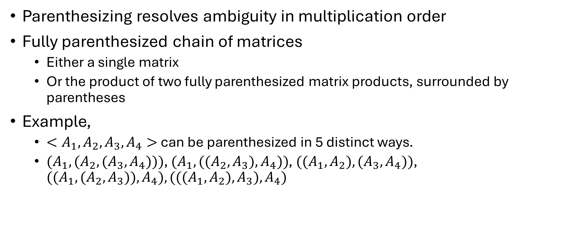
Matrix Chain Multiplication
Parenthesizing resolves ambiguity in multiplication order
Fully parenthesized chain of matrices
Either a single matrix
Or the product of two fully parenthesized matrix products, surrounded by parentheses
Example,
${<A}_{1},A_{2}, A_{3}, A_{4}>$ can be parenthesized in 5 distinct ways.
${(A}_{1},(A_{2}, {(A}_{3}, A_{4})))$, ${(A}_{1},({(A}_{2}, A_{3}), A_{4}))$, ${((A}_{1},A_{2}), {(A}_{3}, A_{4}))$, ${((A}_{1},(A_{2}, A_{3})), A_{4}),{(((A}_{1},A_{2}), A_{3}), A_{4})$

Slide 29
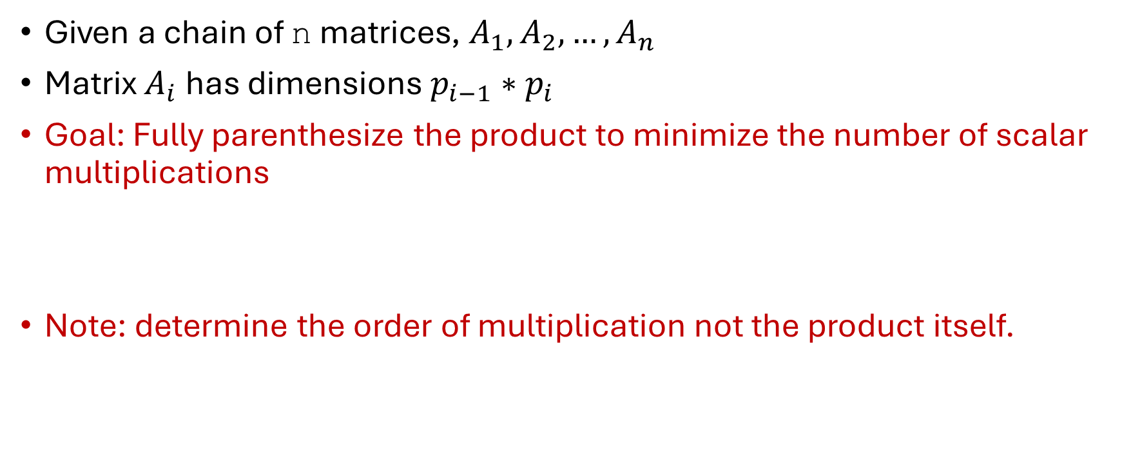
Matrix Chain Multiplication
Given a chain of n matrices, $A_{1},A_{2},…, A_{n}$
Matrix $A_{i}$has dimensions $p_{i−1}∗p_{i}$
Goal: Fully parenthesize the product to minimize the number of scalar multiplications
Note: determine the order of multiplication not the product itself.

Slide 30
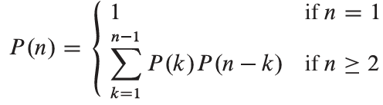

Matrix Chain Multiplication
Fully parenthesized product
Split the product into fully parenthesized subproducts
Let, the first split occurs between kth and (k+1)st matrices
How many possible ways?
$$Ω(2^{n})$$

Slide 31

Matrix Chain Multiplication
Let, $m[i, j] =$ The minimum number of scalar multiplications needed to compute the matrix $A_{i:j}$
We need to find $m[1, n]$

Slide 32


Matrix Chain Multiplication
The optimal parenthesization
Split the product $A_{i:j}$ between $A_{k}$ and $A_{k+1}$ for some value of ${i≤k<j}_{ }$
$$m\left[i, j\right]=m\left[i, k\right]+m\left[k+1, j\right]+p_{i−1}∗p_{k}∗p_{j}$$
We need to consider all such splits, i.e., all values of k

Slide 33
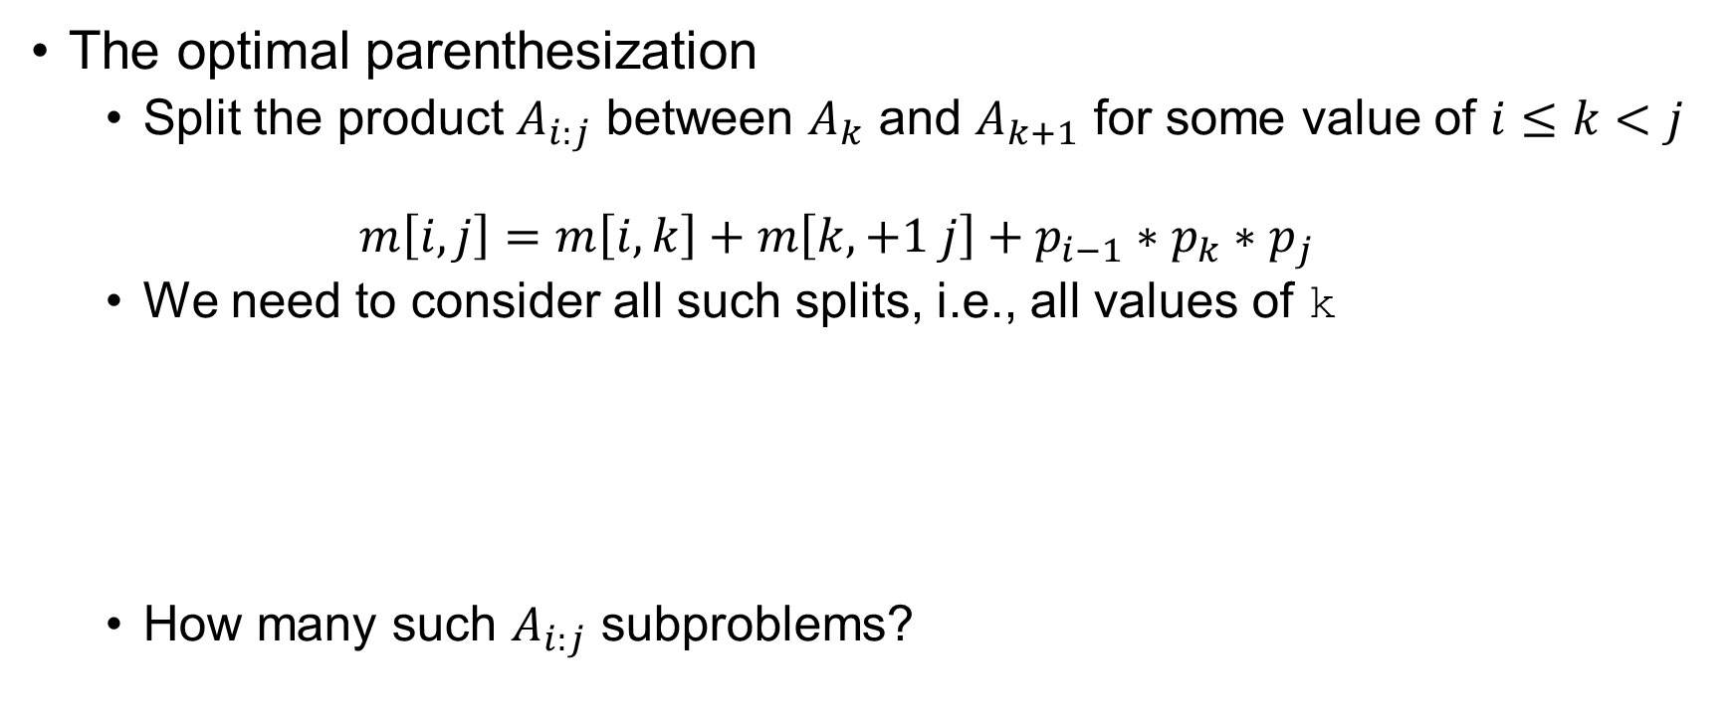

Matrix Chain Multiplication
The optimal parenthesization
Split the product $A_{i:j}$ between $A_{k}$ and $A_{k+1}$ for some value of ${i≤k<j}_{ }$
$$m\left[i, j\right]=m\left[i, k\right]+m\left[k,+1 j\right]+p_{i−1}∗p_{k}∗p_{j}$$
We need to consider all such splits, i.e., all values of k
How many such $A_{i:j}$ subproblems?
$$Θ(n^{2})$$

Slide 34
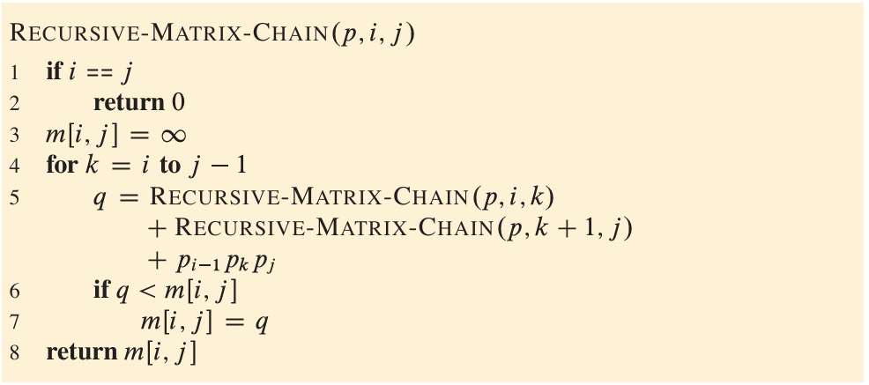
Matrix Chain Multiplication

Slide 35
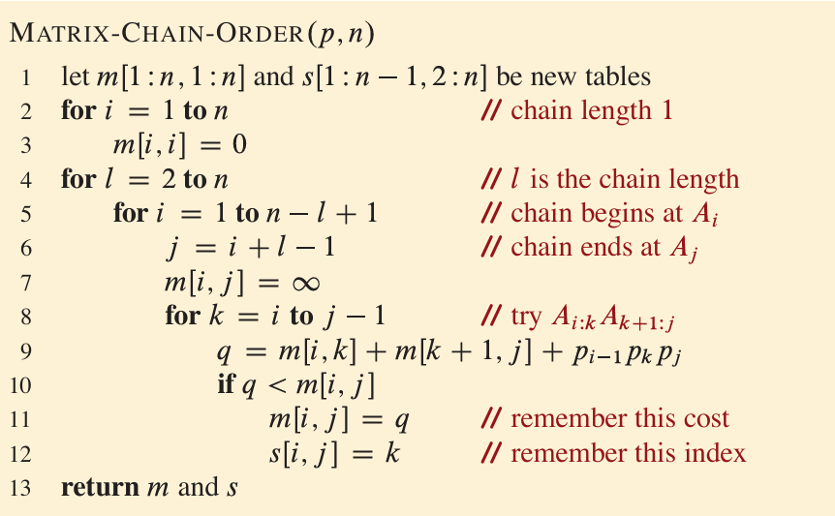
Matrix Chain Multiplication

Slide 36
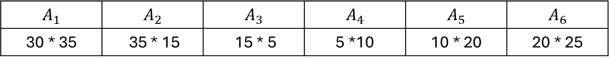
Matrix Chain Multiplication
$$A_{1}$$ | $$A_{2}$$ | $$A_{3}$$ | $$A_{4}$$ | $$A_{5}$$ | $$A_{6}$$
30 * 35 | 35 * 15 | 15 * 5 | 5 *10 | 10 * 20 | 20 * 25
j\i
1 | 2 | 3 | 4 | 5 | 6
1
2
3
4
5
6
0
15750
0
m[1, 3] = min(
m[1,1] + m[2, 3] + 30*35*5 = 7875,
m[1,2] + m[3, 3] + 30*15*5 = 18000,
)
7875
2625
0
4375
750
0
2500
1000
0
3500
5000
0

Slide 37
Matrix Chain Multiplication
$$A_{1}$$ | $$A_{2}$$ | $$A_{3}$$ | $$A_{4}$$ | $$A_{5}$$ | $$A_{6}$$
30 * 35 | 35 * 15 | 15 * 5 | 5 *10 | 10 * 20 | 20 * 25
j\i
1 | 2 | 3 | 4 | 5 | 6
1
2
3
4
5
6
0
15750
0
m[2, 5] = min(
m[2,2] + m[3, 5] + 35*15*20 = 13000,
m[2,3] + m[4, 5] + 35*5*20 = 7125,
m[2,4] + m[5, 5] + 35*10*20 = 11375
)
7875
2625
0
9375
4375
750
0
11875
7125
2500
1000
0
15125
10500
5375
3500
5000
0

Slide 38
Elements of dynamic programming (Revisit)
Optimal substructure.
Optimal solutions to sub-problems can be used to find the optimal solution of the original problem.
Overlapping subproblems.
The subproblems show up again and again

Slide 39
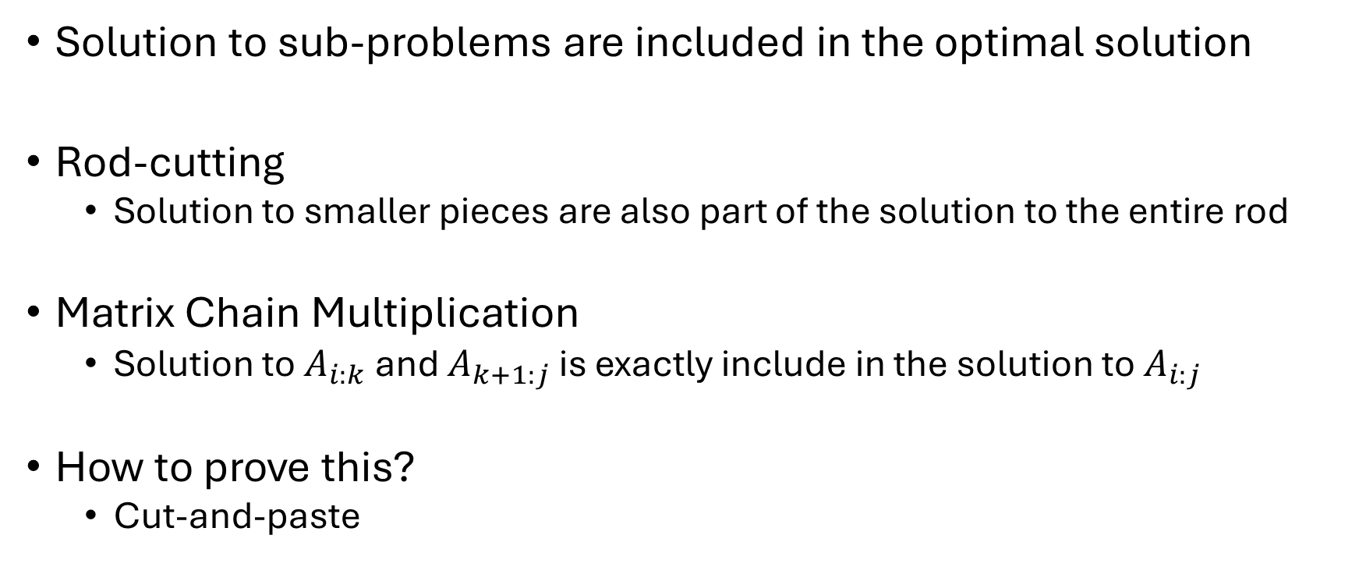
Optimal Substructure Property
Solution to sub-problems are included in the optimal solution
Rod-cutting
Solution to smaller pieces are also part of the solution to the entire rod
Matrix Chain Multiplication
Solution to $A_{i:k}$ and $A_{k+1:j}$ is exactly include in the solution to $A_{i:j}$
How to prove this?
Cut-and-paste

Slide 40
Longest Common Subsequence
A strand of DNA consists of a string of molecules called bases
Adenine, Cytosine, Guanine, and Thymine
ACGT
S1 = ACCGGTCGAGTGCGCGGAAGCCGGCCGAA
S2 = GTCGTTCGGAATGCCGTTGCTCTGTAAA

Slide 41
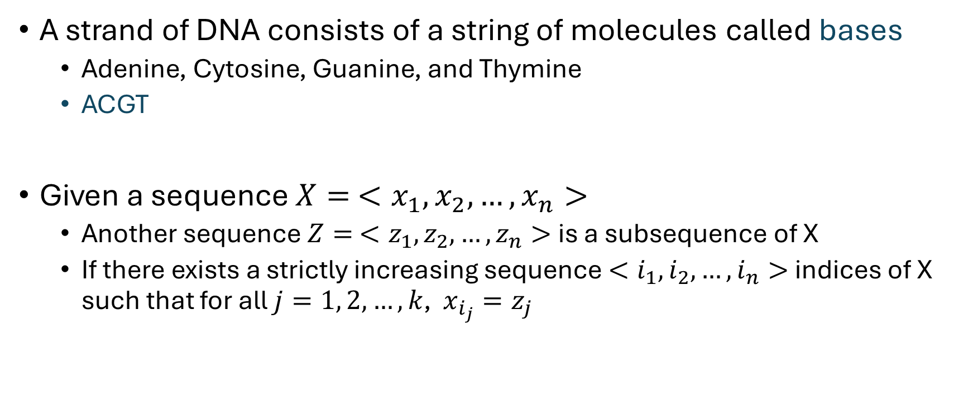
Longest Common Subsequence
A strand of DNA consists of a string of molecules called bases
Adenine, Cytosine, Guanine, and Thymine
ACGT
Given a sequence $X= <x_{1},x_{2},…, x_{n}>$
Another sequence $Z= <z_{1},z_{2},…, z_{n}>$is a subsequence of X
If there exists a strictly increasing sequence $<i_{1},i_{2},…, i_{n}>$ indices of X such that for all $j=1, 2,…,k$, $x_{i_{j}}=z_{j}$

Slide 42
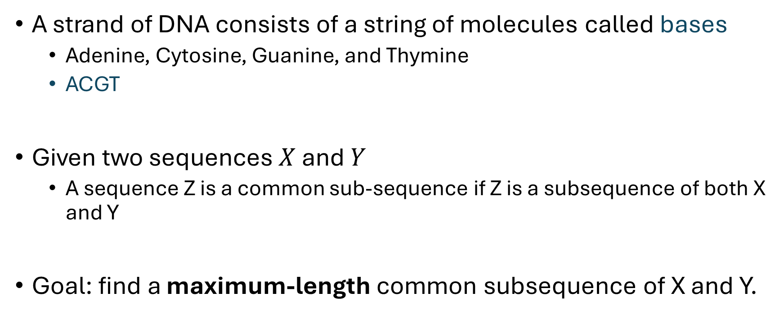
Longest Common Subsequence
A strand of DNA consists of a string of molecules called bases
Adenine, Cytosine, Guanine, and Thymine
ACGT
Given two sequences $X$ and $Y$
A sequence Z is a common sub-sequence if Z is a subsequence of both X and Y
Goal: find a maximum-length common subsequence of X and Y.

Slide 43

Longest Common Subsequence
Need to consider all subsequences
How many subsequences of X?
$2^{n}$

Slide 44
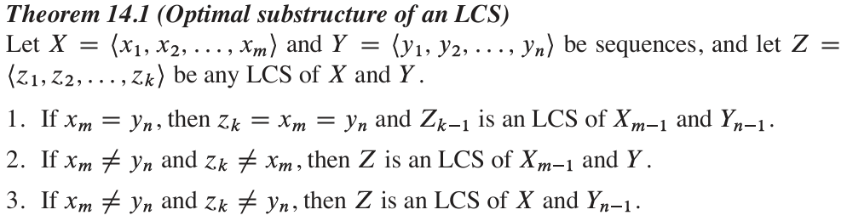

Longest Common Subsequence
Given a sequence $X= <x_{1},x_{2},…, x_{n}>$
The $ith$ prefix of $X$ is $X_{i}= <x_{1},x_{2},…, x_{i}>$

Slide 45
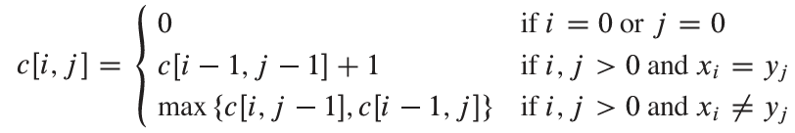

Longest Common Subsequence
Let $c[i, j]$ = the length of an LCS of the sequences $X_{i}$ and $Y_{j}$

Slide 46
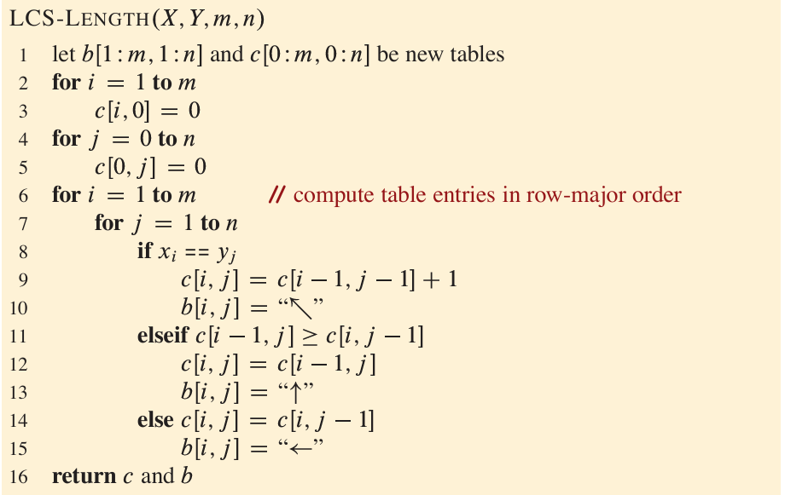
Longest Common Subsequence

Slide 47
Longest Common Subsequence
j
0
1
2
3
4
5
6
i
B
D
C
A
B
A
0
0
0
0
0
0
0
0
1
A
0
0
0
0
1
2
B
0
3
C
0
4
B
0
5
D
0
6
A
0
7
B
0

Slide 48
Longest Common Subsequence
j
0
1
2
3
4
5
6
i
B
D
C
A
B
A
0
0
0
0
0
0
0
0
1
A
0
0
0
0
1
1
1
2
B
0
1
1
1
1
2
2
3
C
0
1
1
2
2
2
2
4
B
0
1
1
2
2
3
3
5
D
0
1
2
2
2
3
3
6
A
0
1
2
2
3
3
4
7
B
0
1
2
2
3
4
4

Slide 49
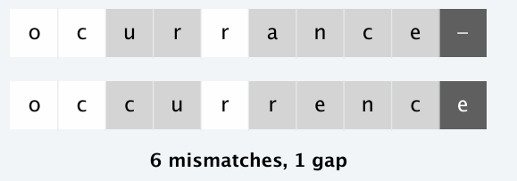
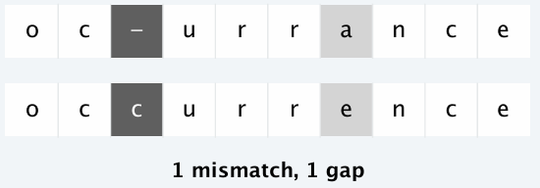
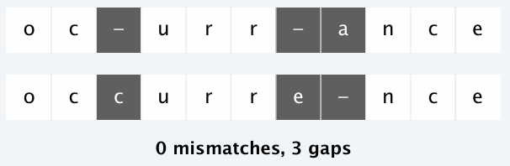
Sequence Alignment
How similar are two strings?
ocurrance vs occurrence

Slide 50
Sequence Alignment
Edit distance
Gap penalty and mismatch penalty
Cost is sum of all penalties

Slide 51

Sequence Alignment
Given two sequences
$x_{1}x_{2}…x_{n}$ and $y_{1}y_{2}…y_{n}$
An alignment is a set of ordered pairs ${(x}_{i}, y_{j})$ such that each character appears in at most one pair and there are no crossings.
Crossing: ${(x}_{i}, y_{j})$ and ${(x}_{i′}, y_{j′})$ cross if $i<i′$ but $j>j′$

Slide 52
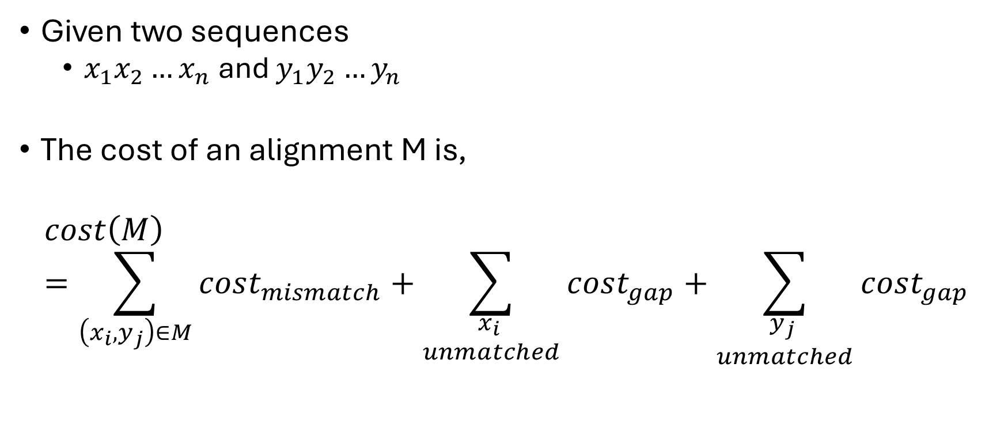
Sequence Alignment
Given two sequences
$x_{1}x_{2}…x_{n}$ and $y_{1}y_{2}…y_{n}$
The cost of an alignment M is,
$$cost\left(M\right)=\sum_{\left(x_{i}, y_{j}\right)∈M}{cost_{mismatch}}+\sum_{\begin{aligned}x_{i} \\ unmatched\end{aligned}}{cost_{gap}}+\sum_{\begin{aligned}y_{j} \\ unmatched\end{aligned}}{cost_{gap}}$$

Slide 53

Sequence Alignment
Given two sequences
$x_{1}x_{2}…x_{n}$ and $y_{1}y_{2}…y_{n}$
Goal: Find minimum cost alignment of the two sequences

Slide 54

Sequence Alignment
Given two sequences
$x_{1}x_{2}…x_{n}$ and $y_{1}y_{2}…y_{n}$
$OPT\left(i, j\right)=$ minimum cost of aligning $x_{1}x_{2}…x_{i}$ and $y_{1}y_{2}…y_{j}$

Slide 55

Sequence Alignment
$OPT\left(i, j\right)=$ minimum cost of aligning $x_{1}x_{2}…x_{i}$ and $y_{1}y_{2}…y_{j}$
Case 1: $OPT\left(i, j\right)$matches ${(x}_{i}, y_{j})$
Pay mismatch for ${(x}_{i}, y_{j})$ + min cost of aligning $x_{1}x_{2}…x_{i−1}$ and $y_{1}y_{2}…y_{j−1}$
$cost_{mismatch}$+ $OPT\left(i−1, j−1\right)$

Slide 56

Sequence Alignment
$OPT\left(i, j\right)=$ minimum cost of aligning $x_{1}x_{2}…x_{i}$ and $y_{1}y_{2}…y_{j}$
Case 2: $OPT\left(i, j\right)$leaves $x_{i}$ unmatched
Pay gap for $x_{i}$ + min cost of aligning $x_{1}x_{2}…x_{i−1}$ and $y_{1}y_{2}…y_{j}$
$cost_{gap}$+ $OPT\left(i−1, j\right)$

Slide 57

Sequence Alignment
$OPT\left(i, j\right)=$ minimum cost of aligning $x_{1}x_{2}…x_{i}$ and $y_{1}y_{2}…y_{j}$
Case 3: $OPT\left(i, j\right)$leaves $y_{j}$ unmatched
Pay gap for $y_{j}$ + min cost of aligning $x_{1}x_{2}…x_{i}$ and $y_{1}y_{2}…y_{j−1}$
$cost_{mismatch}$+ $OPT\left(i, j−1\right)$

Slide 58
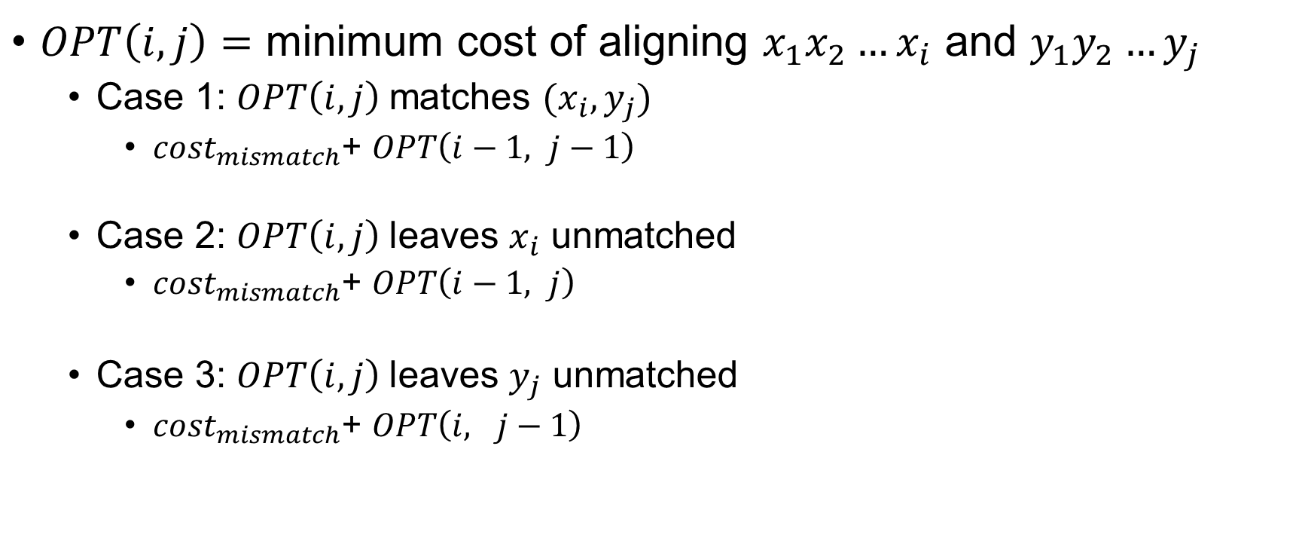
Sequence Alignment
$OPT\left(i, j\right)=$ minimum cost of aligning $x_{1}x_{2}…x_{i}$ and $y_{1}y_{2}…y_{j}$
Case 1: $OPT\left(i, j\right)$matches ${(x}_{i}, y_{j})$
$cost_{mismatch}$+ $OPT\left(i−1, j−1\right)$
Case 2: $OPT\left(i, j\right)$leaves $x_{i}$ unmatched
$cost_{mismatch}$+ $OPT\left(i−1, j\right)$
Case 3: $OPT\left(i, j\right)$leaves $y_{j}$ unmatched
$cost_{mismatch}$+ $OPT\left(i, j−1\right)$

Slide 59
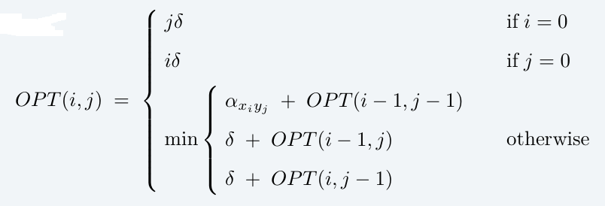

Sequence Alignment
$OPT\left(i, j\right)=$ minimum cost of aligning $x_{1}x_{2}…x_{i}$ and $y_{1}y_{2}…y_{j}$

Slide 60
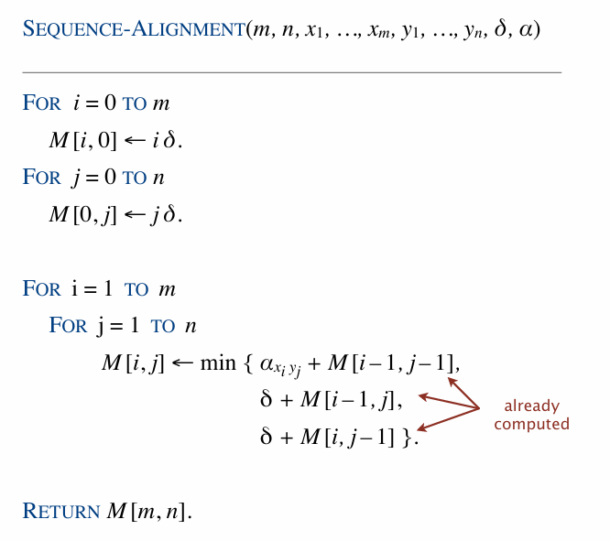
Sequence Alignment

Slide 61


0-1 Knapsack Problem
Given,
n items where item $i$ has value $v_{i} > 0$ and weighs $w_{i} > 0$
Value of a subset of items = sum of values of individual items.
Knapsack has weight limit of $W$
Goal. Pack knapsack so as to maximize total value of items taken.
Example, {1, 2, 5} yields 35$ while {3, 4} yields 40$.

Slide 62

0-1 Knapsack Problem
$OPT(i, w)$ = optimal value of knapsack problem with items $1, …, i$, subject to weight limit $w$
Goal: Find $OPT(n, W)$

Slide 63

0-1 Knapsack Problem
$OPT(i, w)$ = optimal value of knapsack problem with items $1, …, i$, subject to weight limit $w$
Case 1: Don’t pick item $i$
$OPT(i, w)$ selects best of $\{1, 2, …, i – 1\}$ subject to weight limit $w$
Case 2: Pick item $i$
$OPT(i, w)$ selects best of $\{1, 2, …, i – 1\}$ subject to weight limit $w−w_{i}$
Collect value $v_{i}$

Slide 64

0-1 Knapsack Problem
$OPT(i, w)$ = optimal value of knapsack problem with items $1, …, i$, subject to weight limit $w$
Case 1: Don’t pick item $i$
$OPT\left(i, w\right)=OPT(i−1, w)$
Case 2: Pick item $i$
$OPT\left(i, w\right)=v_{i}+OPT(i−1, w)$

Slide 65


0-1 Knapsack Problem
$OPT(i, w)$ = optimal value of knapsack problem with items $1, …, i$, subject to weight limit $w$

Slide 66

0-1 Knapsack Problem

Slide 67

0-1 Knapsack Problem

Slide 68
Reference
Dynamic Programming
CLRS 4th Ed. Chapter 14 (14.1 – 14.4)
KT Sections 6.4 (The Knapsack Problem), 6.6

